Slide 1
Biz Kid$
Who says teaching EPF SOLs can’t be fun?

Slide 4
Who Remembers This Guy?

Slide 5
13
2

Slide 6
National
Success
Has aired on over 340 public TV stations, reaching 98% of the country.
Biz Kid$ episodes have been broadcast more than 373,000 times since 2008.
Since the series launched in 2008, it has reached
more than 65 million viewers. In an average year, Biz Kid$ reaches 9.6 million viewers.
\
Notes:
6

Slide 7
Here’s your Nickel Tour!
A Look at the Kid$
A Walk Through the Website & Lesson Plans
About Your Virginia Starter Kit
How to Get More Biz Kid$ in Your Class
Notes:
7

Slide 8
A Five Minute Peek
(We can watch more during lunch if you want!)

Slide 9
www.bizkids.com

Slide 11
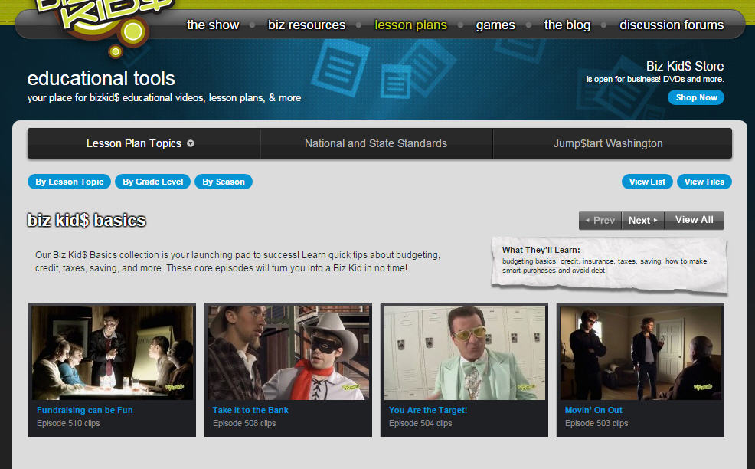

Slide 13
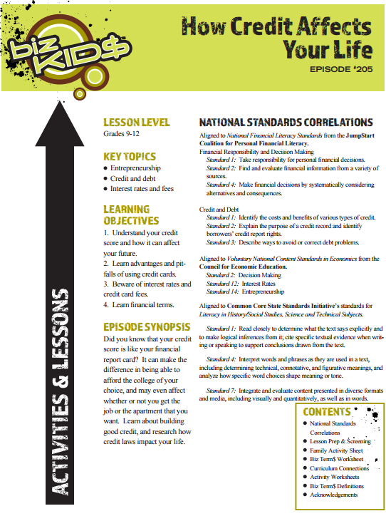

Slide 14
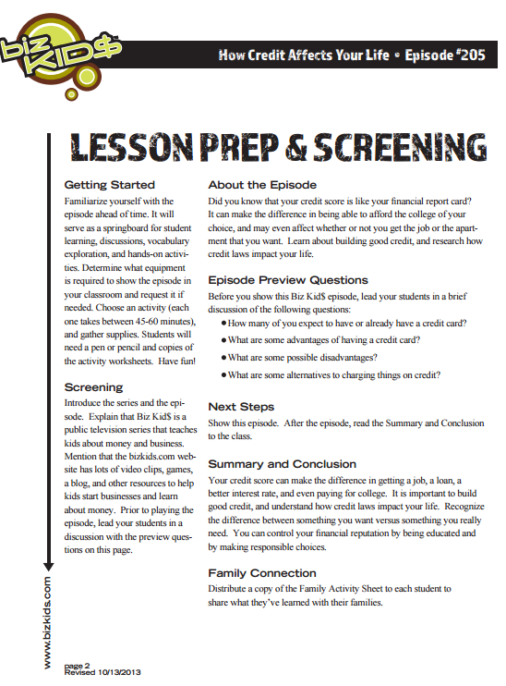

Slide 15
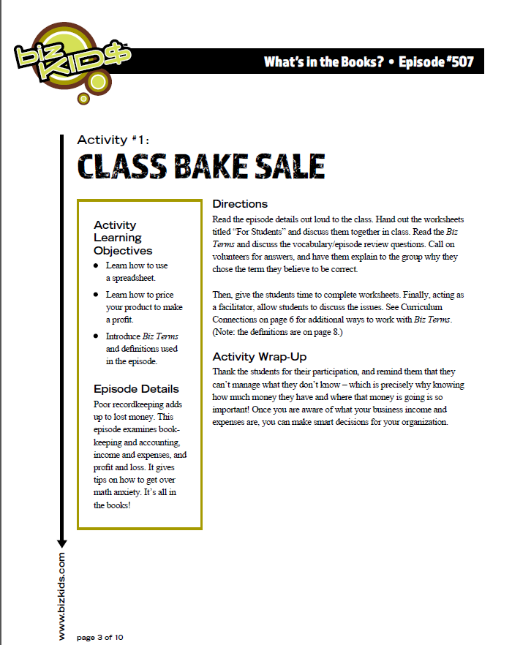

Slide 17
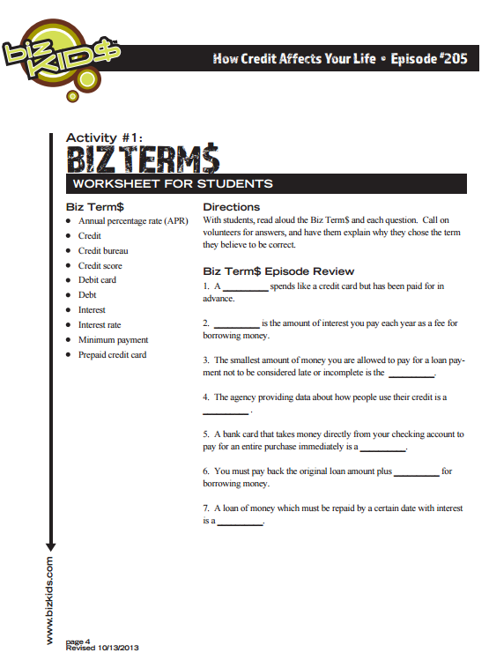

Slide 18
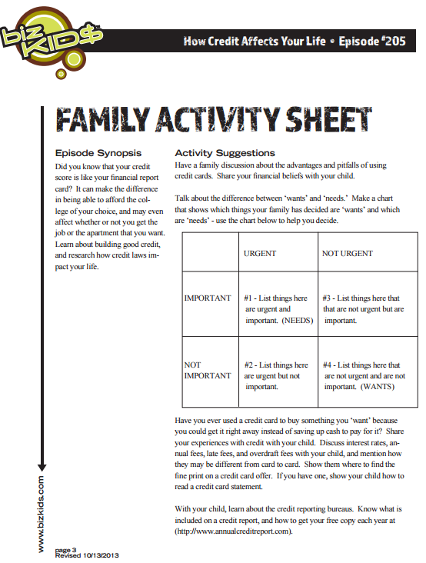

Slide 19
National & State Standards
Jump$tart Coalition for Financial Literacy’s Standards
Virginia State EPF SOLs (Handout!)
National Center on Education & the Economy
National Content Standards for Entrepreneurship Education
Common Core Standards
Notes:
19

Slide 20
About Your VA DVD Set
17 Episodes Touch on all EPFs
Must Register &Take a Follow Up 5Q Survey
Limit 2 Sets Per School
Lesson Plans Included
Order More through Credit Unions ($70 set)
Thank you, NCUF!
Notes:
20

Slide 21
Thematic Learning Blocks
Biz Kid$ Basics
Careers
Credit & Debit
Entrepreneurship
Financial Markets & the Economy
Financial Planning
Personal Finances
Savings & Investing
Spanish Lesson Plans
(pssst… this is a handout.)
Notes:
21

Slide 23
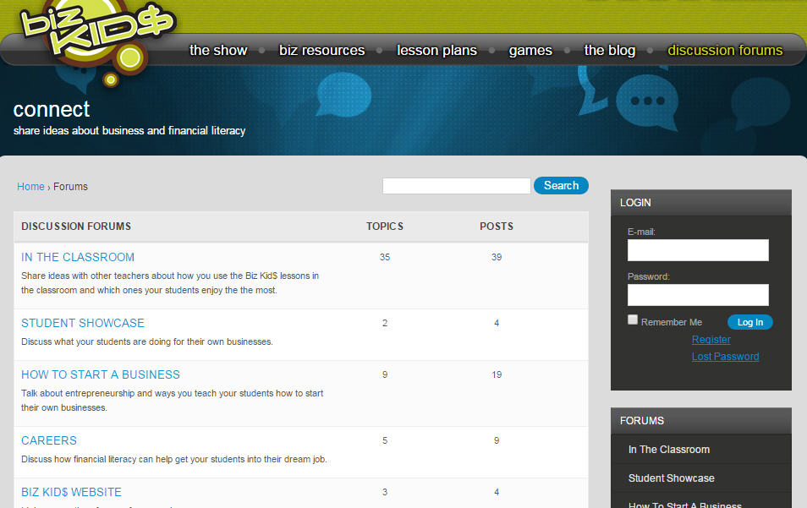

Slide 25
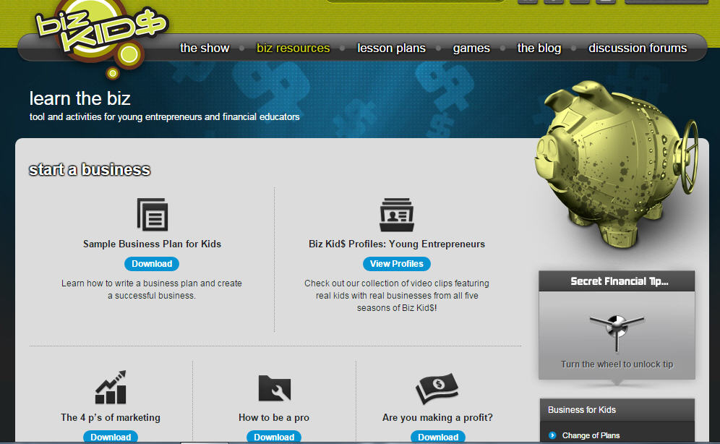

Slide 27
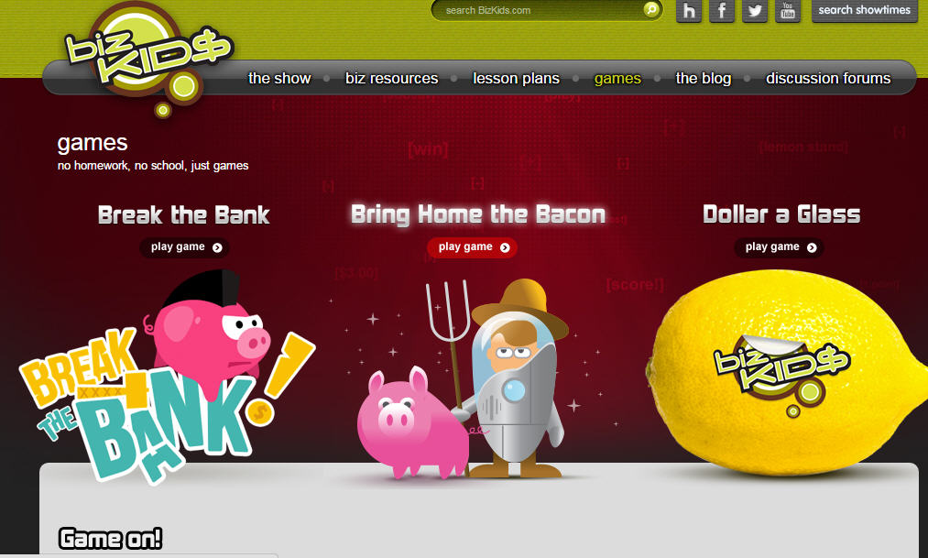

Slide 28
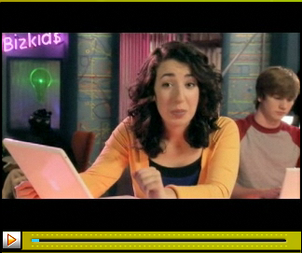
Access to Biz Kid$
Virginia Starter Kit (Handout!)
Public Television
Clips from Biz Kid$ website
Streaming packages for schools
YouTube Channel (hypnologic)
DVD Season Box Sets
Notes:
28

Slide 29
For more information, contact:
Mary Amyx
mamyx@vacul.org
800-768-3344, x630
Notes:
29
29

